Slide 1
DSI Coding Workshop
Introduction to Robotics for Teachers
2 October 2024

Slide 2







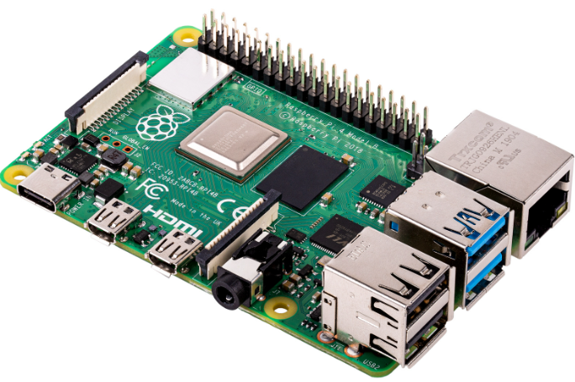
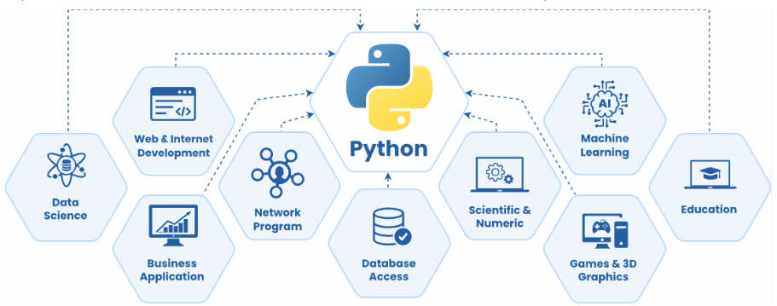




Presenter: Binjamin (Bin-ya-meen) Barsch
2008 - 2012
(BEng)
2012 - 2020
(Electronic & Software Engineer / MEng)
2020 – Present
(Lead Software Engineer)

Slide 3
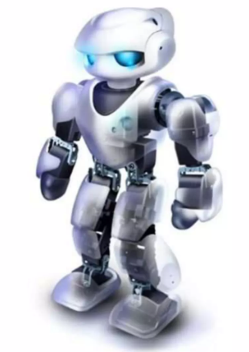
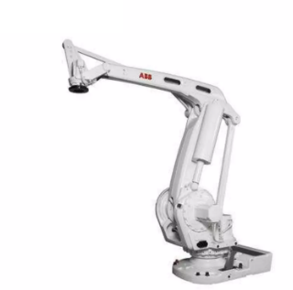
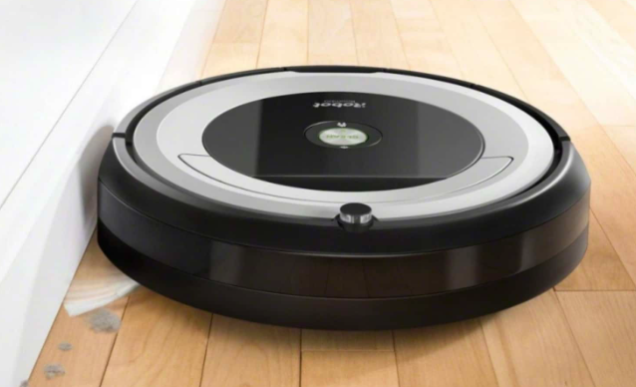
What is a Robot?

Slide 4

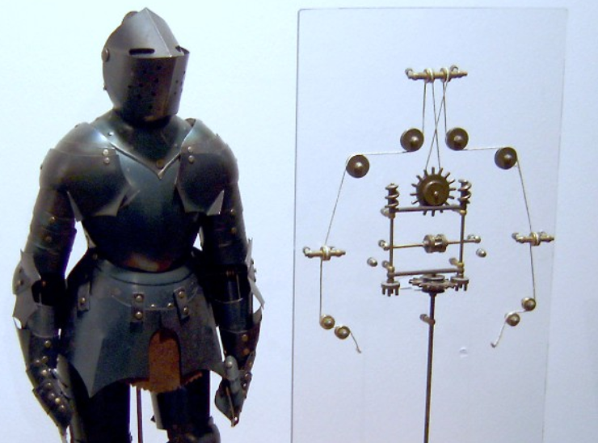
What is a Robot?
Around 1495, Leonardo di Vinci drew up plans for a mechanical knight – an armour-clad ‘robot’ that could sit up, move its head, and even wave a sword in its hands.

Slide 5
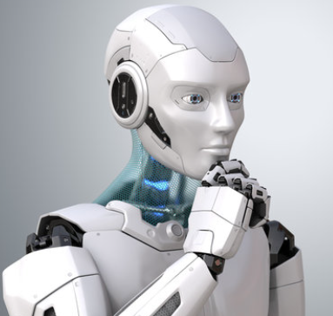

What is a Robot?
“robot, any automatically operated machine that replaces human effort, though it may not resemble human beings in appearance or perform functions in a humanlike manner. By extension, robotics is the engineering discipline dealing with the design, construction, and operation of robots.
The concept of artificial humans predates recorded history (see automaton), but the modern term robot derives from the Czech word robota (“forced labour” or “serf”), used in Karel Čapek’s play R.U.R. (1920)”
“A machine designed to execute a task repeatadly”

Slide 6
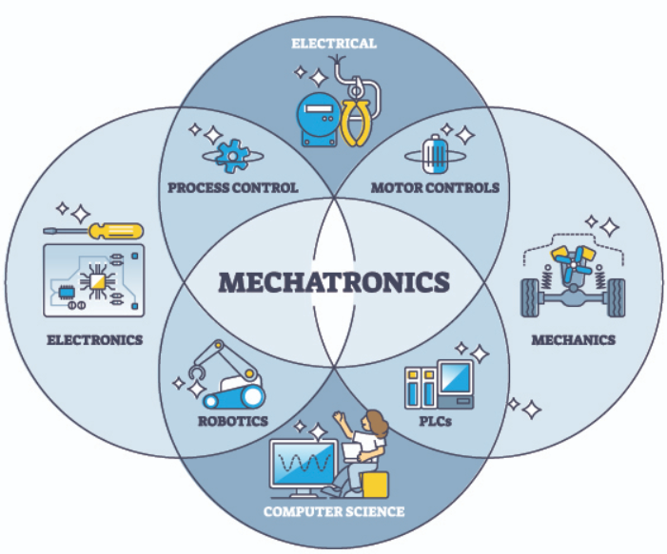
What is Robotics?
Definition: Robotics is the interdisciplinary field that involves the design, construction, and operation of robots.
Core Components:
Mechanics: Structure and movement
Electronics: Power and control systems
Programming: Logic and decision-making
The field of mechatronics is closed related to robotics.

Slide 7
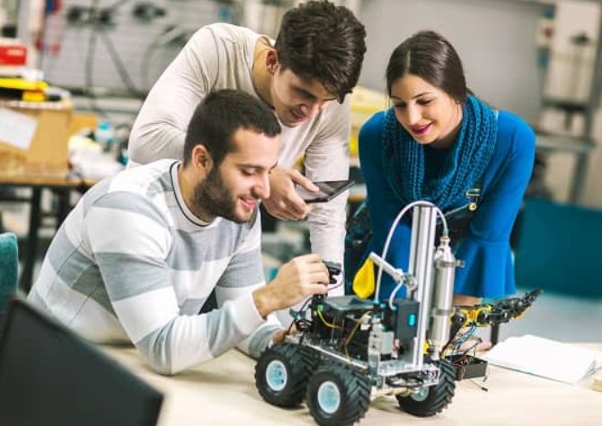
Why Teach Robotics?
STEM Learning: Combines science, technology, engineering, and mathematics in an engaging way.
Career Opportunities: Prepares students for future tech-related jobs.
21st Century Skills:
Problem-solving
Critical thinking
Collaboration
Creativity
Artificial Intelligence (AI) *

Slide 8
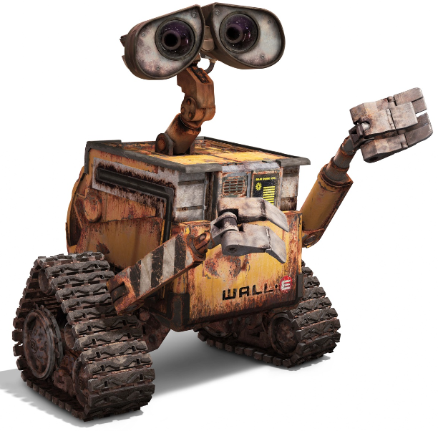
Mechanics In Robotics
Definition: Mechanics refers to the physical structure of the robot—its body, limbs, joints, and gears.
Key Components:
Frames and Chassis: The backbone of the robot.
Motors and Actuators: Create movement.
Wheels/Tracks/Legs: Provide mobility.
Arms/Grippers: Allow the robot to interact with objects.
Example: A robotic arm uses motors to control the joints, allowing it to pick up objects.

Slide 9
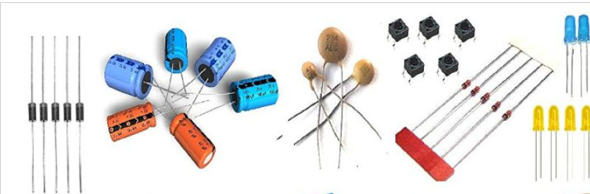
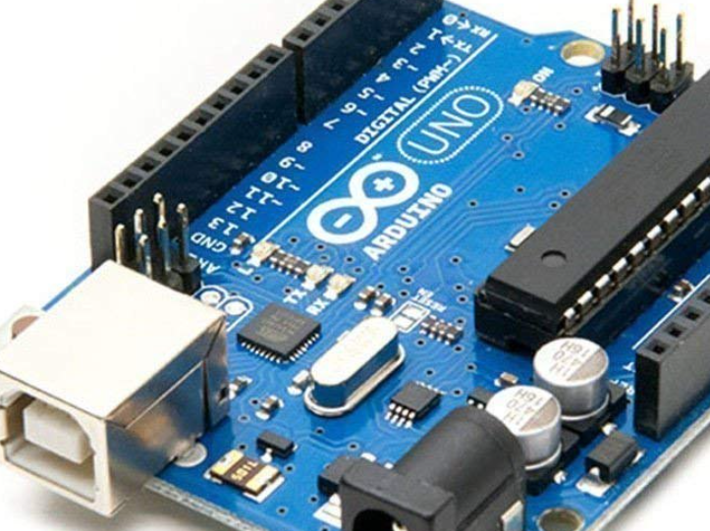
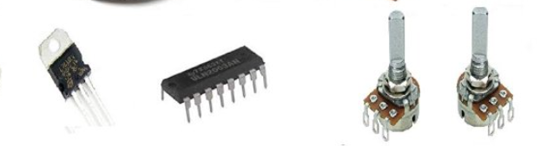
Electronics (Electrical) In Robotics
Definition: Electronics provide power and control to the mechanical parts.
Key Components:
Power Supply: Battery or external power source.
Microcontroller/Microprocessor: Acts as the brain of the robot
Motors and Drivers: Convert electrical energy into motion.
Wiring & Circuits: Connect all components.
Example: A motor driver controls the speed and direction of a DC motor based on commands from the microcontroller.

Slide 10
Microcontroller
Definition: A microcontroller is like small computer on a single integrated circuit (IC) designed to control devices or processes.
Basics:
CPU: The brain of the microcontroller that executes programs and instructions.
Memory: Used to store instructions and information
I/O Pins: Connect to external devices, such as sensors, motors, or displays, allowing the microcontroller to interact with the physical world.

Slide 11
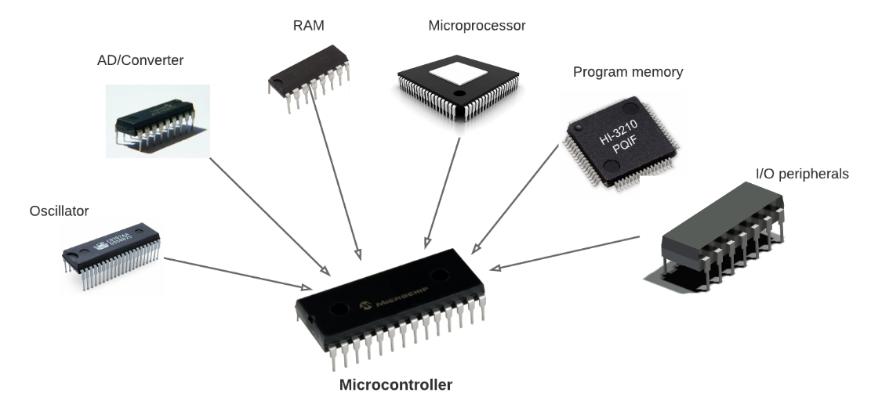
Microcontroller

Slide 12
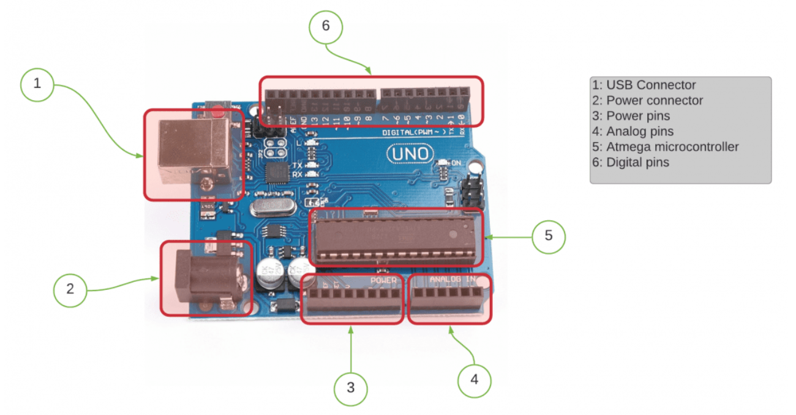
Microcontroller on an Arduino Board

Slide 13
Microcontroller vs Microprocessor
Microcontrollers are self-contained systems with all components needed for control in a single chip. They are optimized for controlling tasks and are found in everyday devices like microwaves, thermostats, and toys.
Microprocessors, in contrast, are more powerful but require external components (like RAM and storage) to function. These are used in cell phones, computers like desktops and laptops.

Slide 14
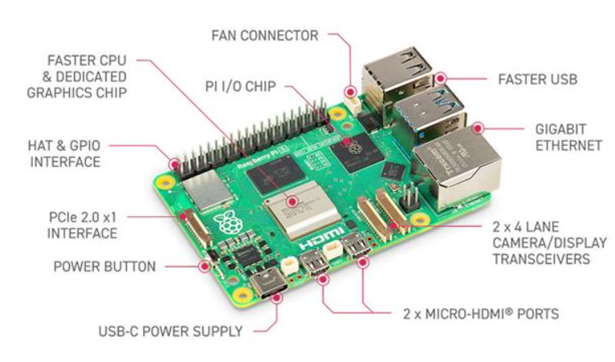
Microprocessor/CPU on Raspberry Pi Board

Slide 15
Servo Motor
A servo motor is a type of motor that provides precise control of angular or linear position, speed, and torque.
Unlike regular motors, which simply rotate continuously, a servo motor can be instructed to move to a specific position and hold that position until further instructions are given.
This makes it highly useful in applications requiring accurate movement and control, such as in robotics, drones, and automation systems.

Slide 16
Servo Motor
A servo motor system typically consists of three key components:
Motor: The electric motor that provides the rotational or linear movement.
Control Circuit: Receives a signal (usually a Pulse Width Modulation, or PWM, signal) that tells the motor how far to move and in what direction.
Feedback Mechanism: Usually a potentiometer or encoder that monitors the motor's position and sends feedback to the control circuit. This allows the motor to adjust and maintain its desired position accurately.

Slide 17
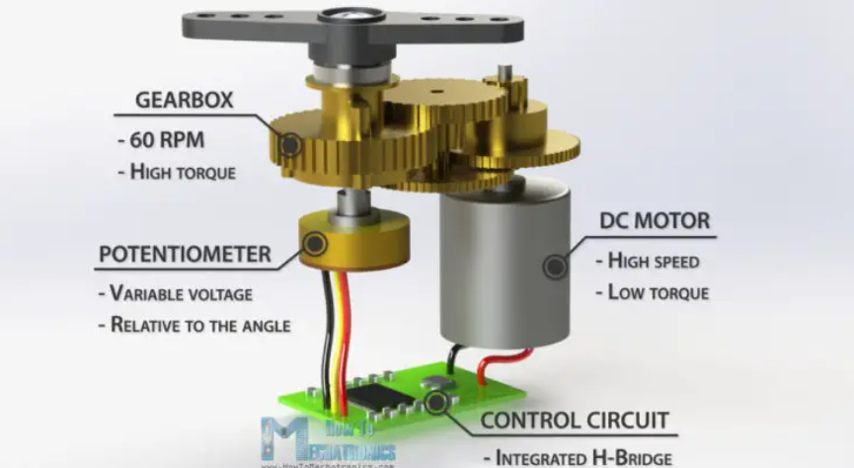
Servo Motor

Slide 18
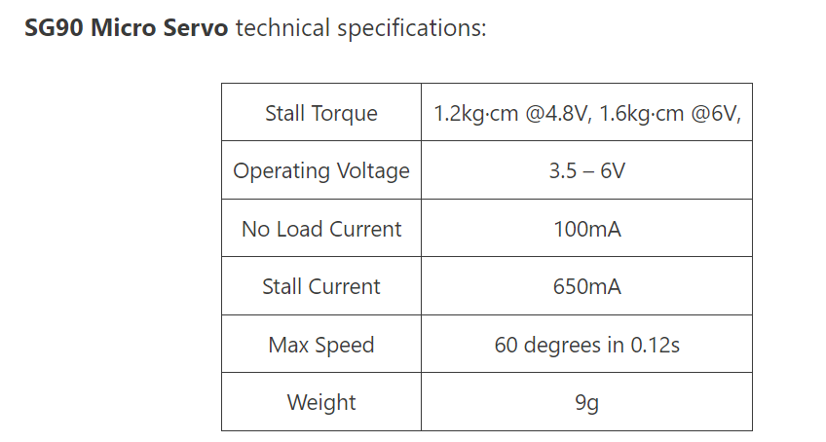
Servo Motor

Slide 19
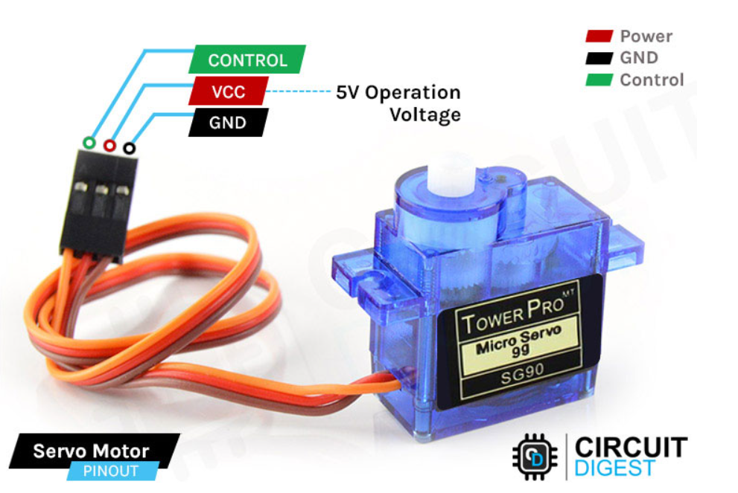
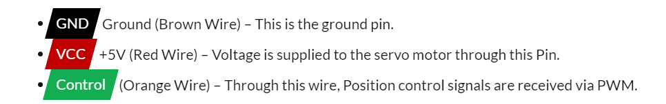
Servo Motor

Slide 20
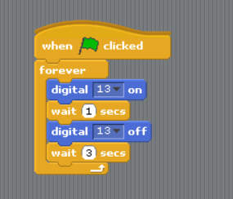
Programming In Robotics
Definition: Programming is the process of writing a set of instructions, known as code, that a computer or other devices like microcontrollers follow to perform specific tasks. These instructions are written in programming languages such as Python, C++, or even visual languages like Scratch.
Key Components:
Programming/Coding Languages: C/C++, Python, Scratch
Control Structure: Loops and conditionals
Functions: Reusable code
Sensor control: Real time processing of data from
environment.
Example: A robot programmed to follow a line uses a loop to
constantly check sensor data and adjust movement.

Slide 21
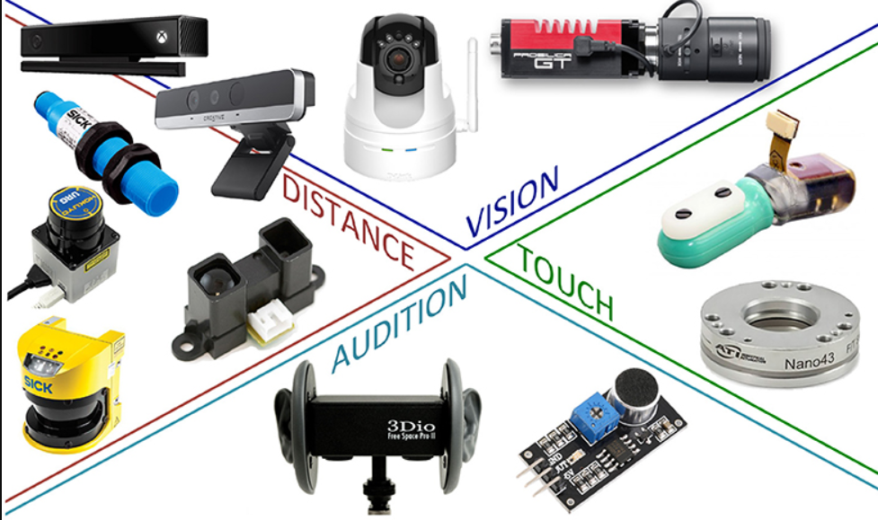
Sensors In Robotics
Definition: Sensors provide robots with information about their environment.
Types of Sensors:
Distance Sensors: Measure proximity
(e.g., ultrasonic, infrared).
Light Sensors: Detect light and color.
Touch Sensors: Respond to physical pressure.
Gyroscope/Accelerometer: Measure orientation and movement.
Example: An ultrasonic sensor helps a robot avoid obstacles by detecting objects in its path.

Slide 22
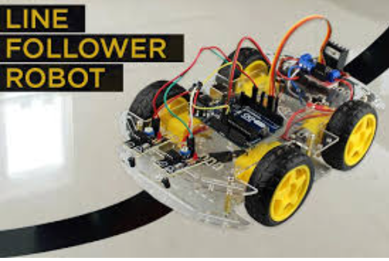
Combining Mechanics, Electronics, and Coding
Example: A line-following robot:
Mechanics: The robot's chassis and wheels provide mobility.
Electronics: Motors and sensors are wired to a microcontroller.
Programming: Code continuously reads sensor data and adjusts the motor speed to stay on track.
Real-world Applications: Autonomous cars,
industrial robots, drones.

Slide 23
Real World Applications and Industries
Healthcare: Medical robots, prosthetics, surgical robots.
Everyday Life: Vacuum cleaning robots and drones.
Manufacturing: Automated production lines.
Agriculture: Autonomous farming equipment.
Defense & Security: Surveillance and unmanned vehicles.
Space Exploration: Rovers, space station robotics.
Future Opportunities: As robotics advances, new fields like autonomous vehicles, smart homes, and human-robot collaboration will continue to emerge.

Slide 24
Careers and Opportunities in Robotics
Growing Industry: Robotics is an expanding field with applications in multiple sectors.
In-Demand Skills:
Mechanical Engineering
Electrical Engineering
Computer Science & Programming
Artificial Intelligence (AI) & Machine Learning
Data Analysis
Career Opportunities:
Robotics Engineer: Design and build robots.
Automation Specialist: Develop robotic systems for industry.
AI/ML Developer: Create intelligent robots that can learn and adapt.
Research Scientist: Work on advanced robotics technologies.

Slide 25
Robotics in the Classroom
Robotics in Education:
Hands-on learning that enhances engagement and creativity.
Develops problem-solving skills through trial and error.
Encourages teamwork through collaborative projects.
Integrates multiple subjects: science, technology, engineering, and math (STEM).
Robotics in the Classroom:
Household Items
Robotic kits (Arduino, Raspberry pi, etc)
Use virtual platforms (e.g., Scratch)

Slide 26
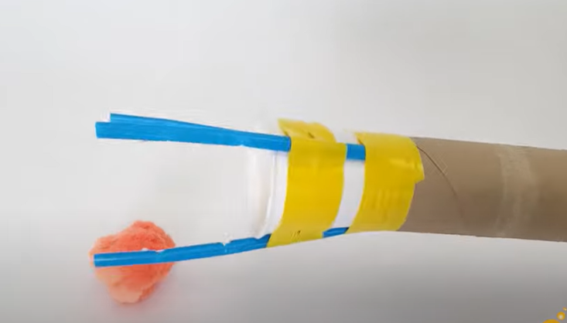
DIY Robotic Hand Using Household Items
Objective: Create a simple robotic hand using everyday materials to teach the principles of mechanics and motion.
Materials Needed:
Cardboard tube (from a kitchen roll or toilet paper roll)
Straws (5 plastic straws for fingers)
String (to control finger movement)
Tape or glue (for assembly)
Scissors (to cut materials)
Steps:
Cut 5 Straws: These will act as fingers.
Cut small notches to create "joints" where the fingers will bend.
Thread String: Thread a piece of string through each straw.
Tie a knot at the tip of the straw and leave enough string hanging out the other end to pull.
Attach to Cardboard Tube: Use tape or glue to attach the straws (fingers) to the cardboard tube (hand base). Ensure the strings are free to move.
Create Finger Movement: When the string is pulled, the notched straws will bend, simulating finger movement.
Test and Improve: Experiment by adjusting the string tension and straw positions to improve the movement.
Lesson: This project demonstrates how tendons and muscles work in the human hand, making it a fun, hands-on way to learn about biomechanics and engineering.

Slide 27
End of Part 1
Any Questions?

Slide 28
DSI Coding Workshop
Building a Robotic Arm
2 October 2024

